Slide 1
Network Coprocessor (NETCP) Overview

Slide 2
Agenda
NETCP Overview
Packet DMA
Packet Accelerator (PA)
Security Accelerator (SA)
Gigabit Ethernet (GbE) Switch Subsystem
Receive Processing Example

Slide 3
Agenda
NETCP Overview
Packet DMA
Packet Accelerator (PA)
Security Accelerator (SA)
Gigabit Ethernet (GbE) Switch Subsystem
Receive Processing Example

Slide 4
What is the Network Coprocessor (NetCP)?
Memory Subsystem
Application-Specific
Hardware accelerator for doing L2, L3, and L4 processing with Encryption, Decryption, and Authentication that was previously done in software
MSM
Coprocessors
64-Bit
SRAM
DDR3 EMIF
MSMC
Debug & Trace
Boot ROM
Semaphore
C66x™
Power
CorePac
Management
PLL
L1
L1
x3
P-Cache
D-Cache
EDMA
L2 Cache
x3
1 to 8 Cores @ up to 1.25 GHz
HyperLink
TeraNet
Multicore Navigator
Queue
Packet
Manager
DMA
x2
-
O
x4
t
s
n
/
e
h
r
T
o
I
n
I
i
c
Security
e
C
R
P
t
c
r
t
h
a
i
h
e
c
f
O
e
i
Accelerator
2
I
I
A
S
i
i
c
t
C
l
c
I
h
w
t
O
U
p
e
R
t
S
i
P
p
p
S
E
w
A
S
S
Packet
Accelerator
I
I
x2
M
G
S
Network Coprocessor

Slide 5
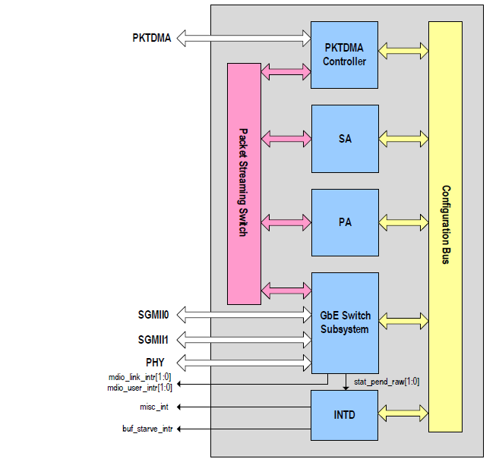
Network Coprocessor (NETCP)
Network Coprocessor consists of the following modules:
Packet DMA (PKTDMA) Controller
Packet Accelerator (PA)
Security Accelerator (SA)
Ethernet Switch Subsystem
Notes:
5
NEW

Slide 6
Agenda
NETCP Overview
Packet DMA
Packet Accelerator (PA)
Security Accelerator (SA)
Gigabit Ethernet (GbE) Switch Subsystem
Receive Processing Example

Slide 7
Packet DMA in NETCP
FFTC (B)
Queue Manager Subsystem
FFTC (A)
SRIO
Queue Manager
PKTDMA
0
1
PKTDMA
PKTDMA
2
3
4
5
.
.
.
8192
AIF
PKTDMA
Network
Coprocessor
PKTDMA
PKTDMA
Notes:
NEW

Slide 8
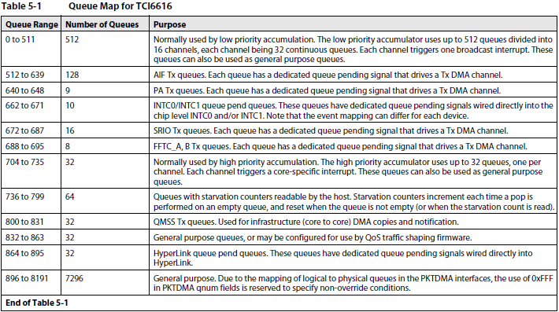
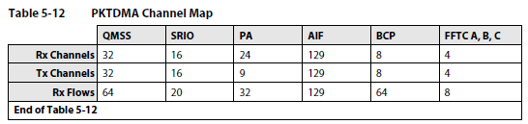
Communication with the NETCP
NETCP relies on QMSS and PKTDMA to communicate with the CorePac.
TX Queue Mapping
Q640: PDSP1
Q641: PDSP2
Q642: PDSP3
Q643: PDSP4
Q644: PDSP5
Q645: PDSP6
Q646: SA0
Q647: SA1
Q648: Switch
RX Queues
Can use any general purpose queues (Q864-Q8191)
Can also use other special purpose queues (e.g. 704-735)
Notes:
Lets discuss how to use the Multicore navigator to communicate with the network coprocessor.
Lets begin with transmitting data to the network coprocessor. To transmit data to the network coprocessor, queues 640 through 648 must be used. Each of these queues is mapped to a particular PKTDMA channel, and corresponds to a specific location in the NETCP.
For receive, any of the 8192 queues can be used. For communication with the host, the general purpose queues or the high or low priority accumulation queues will probably be used.
Unlike the transmit queues, the packet dma receive channels are not tied to a specific queue.

Slide 9
Agenda
NETCP Overview
Packet DMA
Packet Accelerator (PA)
Security Accelerator (SA)
Gigabit Ethernet (GbE) Switch Subsystem
Receive Processing Example

Slide 10
PA: High-Level Overview
L2 Classify Engine
Used for matching L2 headers
Example headers: MAC, VLAN, LLC snap
L3 Classify Engine 0
Used for matching L3 headers
Example headers: IPv4, IPv6, Custom L3
Also match ESP headers and direct packets to SA via Multicore Navigator
L3 Classify Engine 1
Typically used for matching L3 headers in IPSec tunnels
Example headers: IPv4, IPv6, Custom L3
L4 Classify Engine
Used for matching L4 Headers
Example headers: UDP, TCP, Custom L4
Modify/Multi-Route Engines
Used for Modification, Multi-route, and Statistics requests
Modification Example: generate IP or UDP header checksums
Multi-route Example: route a packet to multiple queues
PA Statistics Block
Stores statistics for packets processed by the classify engines
Statistics requests typically handled by Modify/Multi-route engines
Packet ID Manager
Assigns packet ID to packets
Notes:
10

Slide 11
Agenda
NETCP Overview
Packet DMA
Packet Accelerator (PA)
Security Accelerator (SA)
Gigabit Ethernet (GbE) Switch Subsystem
Receive Processing Example

Slide 12
SA: High Level Overview
Notes:
12

Slide 13
Agenda
NETCP Overview
Packet DMA
Packet Accelerator (PA)
Security Accelerator (SA)
Gigabit Ethernet (GbE) Switch Subsystem
Receive Processing Example

Slide 14
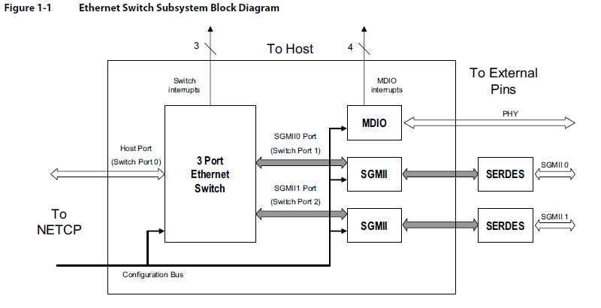
GbE Switch: High Level Overview
Notes:
14

Slide 15
Agenda
NETCP Overview
Packet DMA
Packet Accelerator (PA)
Security Accelerator (SA)
Gigabit Ethernet (GbE) Switch Subsystem
Receive Processing Example

Slide 16
Receive Hardware Processing
Step 1: A IPSec packet formatted with MAC, IPv4, and UDP headers arrives from the gigabit Ethernet switch subsystem and is routed over the packet streaming switch to the L2 Classify Engine.
Q640: PDSP0
Q641: PDSP1
Q642: PDSP2
Q643: PDSP3
Q644: PDSP4
Q645: PDSP5
Q646: SA0
Q647: SA1
Q648: GbE SW
Q900: RXQUEUE
Notes:
16
Now that we have shown the process of how to configure the PA,
lets take a look at an example of how receive packets are processed by the PA.
Assume for the sake of this example, that the L2 classify engine lookup table,
L3 classify engine 0 lookup table,
and the L4 classify engine lookup table have been configured with entries.
Then if we receive a packet formatted with MAC, IPv4, and UDP headers from the gigabit ethernet switch subsystem,
then the receive processing will go as follows.
In the first step, the packet will be routed from the gigabit ethernet switch over the streaming interface switch to the L2 classify engine.

Slide 17
Receive Hardware Processing
Step 2: PDSP0 in the L2 Classify Engine submits the MAC header for lookup. Assume that the lookup is successful. The packet will then be routed to its next destination. Assume that the destination is L3 Classify Engine 0.
PDSP0 LUT1 matches MAC entry.
Q640: PDSP0
Q641: PDSP1
Q642: PDSP2
Q643: PDSP3
Q644: PDSP4
Q645: PDSP5
Q646: SA0
Q647: SA1
Q648: GbE SW
Q900: RXQUEUE
Notes:
17
Step 2: Now that the packet has arrived at the L2 classify engine,
it will examine the MAC header and compare it against the entries in its lookup table.
If the MAC header is successfully matched,
then the packet will be routed according to the matchroute that was specified when the entry was added to the lookup table.
If the lookup fails, then the packet will be routed according to the failure route that was specified when the entry was added to the lookup table.
For this example, lets assume that the addresses match,
and that the entry was added with the pa_DEST_CONTINUE_PARSE destination,
which means that the packet will be routed to through the packet streaming switch to the L3 classify engine 0 to match the IPv4 header.

Slide 18
Receive Hardware Processing
Step 3: The packet is routed from the L3 Classify Engine 0, through the packet streaming switch to the PKTDMA controller. When the IPv4 entry is matched with the SPI, the PKTDMA will then transfer the packet from the NETCP to the SA1 transmit queue.
Q640: PDSP0
PDSP1 LUT1 matches IPv4 entry.
Q641: PDSP1
Q642: PDSP2
Q643: PDSP3
Q644: PDSP4
Q645: PDSP5
Q646: SA0
Q647: SA1
Q648: GbE SW
Q900: RXQUEUE
Notes:
18
In step 5, the packet will be routed through the packet streaming switch to the packet DMA controller.
Once in the packet DMA controller,
the packet DMA will transfer the packet from the network coprocessor to the host,
using the specified receive flow to transmit the packet to queue 900.
This completes the hardware receive processing example.
It is important to note that once the configuration has been completed,
which we assumed was done before starting this example,
this entire process requires no interaction from the host.
It is also important to note that the packet could have come from another location,
and have been formatted with different headers.
An alternate example is that a packet could have arrived the transmit queue for the L3 classify engine,
and could be checked against custom L3 entries that have been added to its lookup table.

Slide 19
Receive Hardware Processing
Step 4: Once the data transfer from the SA1 transmit queue to the NETCP has completed, the PKTDMA controller transfers the packet through the packet streaming switch to the SA, where the packet is decrypted and authenticated.
Q640: PDSP0
Q641: PDSP1
Q642: PDSP2
Q643: PDSP3
Q644: PDSP4
Q645: PDSP5
Q646: SA0
Q647: SA1
Q648: GbE SW
Q900: RXQUEUE
Notes:
19
In step 5, the packet will be routed through the packet streaming switch to the packet DMA controller.
Once in the packet DMA controller,
the packet DMA will transfer the packet from the network coprocessor to the host,
using the specified receive flow to transmit the packet to queue 900.
This completes the hardware receive processing example.
It is important to note that once the configuration has been completed,
which we assumed was done before starting this example,
this entire process requires no interaction from the host.
It is also important to note that the packet could have come from another location,
and have been formatted with different headers.
An alternate example is that a packet could have arrived the transmit queue for the L3 classify engine,
and could be checked against custom L3 entries that have been added to its lookup table.

Slide 20
Receive Hardware Processing
Step 5: The packet is routed from the SA, through the packet streaming switch to the PKTDMA controller. The PKTDMA will then transfer the packet from the NETCP to the PDSP2 transmit queue.
Q640: PDSP0
Q641: PDSP1
Q642: PDSP2
Q643: PDSP3
Q644: PDSP4
Q645: PDSP5
Q646: SA0
Q647: SA1
Q648: GbE SW
Q900: RXQUEUE
Notes:
20
In step 5, the packet will be routed through the packet streaming switch to the packet DMA controller.
Once in the packet DMA controller,
the packet DMA will transfer the packet from the network coprocessor to the host,
using the specified receive flow to transmit the packet to queue 900.
This completes the hardware receive processing example.
It is important to note that once the configuration has been completed,
which we assumed was done before starting this example,
this entire process requires no interaction from the host.
It is also important to note that the packet could have come from another location,
and have been formatted with different headers.
An alternate example is that a packet could have arrived the transmit queue for the L3 classify engine,
and could be checked against custom L3 entries that have been added to its lookup table.

Slide 21
Receive Hardware Processing
Step 6: Once the data transfer from PDSP2 transmit queue to the NETCP has completed, the PKTDMA controller transfers the packet through the packet streaming switch to the L3 Classify Engine 1.
Q640: PDSP0
Q641: PDSP1
Q642: PDSP2
Q643: PDSP3
Q644: PDSP4
Q645: PDSP5
Q646: SA0
Q647: SA1
Q648: GbE SW
Q900: RXQUEUE
Notes:
21
In step 5, the packet will be routed through the packet streaming switch to the packet DMA controller.
Once in the packet DMA controller,
the packet DMA will transfer the packet from the network coprocessor to the host,
using the specified receive flow to transmit the packet to queue 900.
This completes the hardware receive processing example.
It is important to note that once the configuration has been completed,
which we assumed was done before starting this example,
this entire process requires no interaction from the host.
It is also important to note that the packet could have come from another location,
and have been formatted with different headers.
An alternate example is that a packet could have arrived the transmit queue for the L3 classify engine,
and could be checked against custom L3 entries that have been added to its lookup table.

Slide 22
Receive Hardware Processing
Step 7: The packet is routed to the L3 Classify Engine 0. PDSP1 submits the IPv4 header for lookup. Assume that the lookup is successful. The packet will then be routed to its next destination. Assume that it is the L4 Classify Engine.
Q640: PDSP0
Q641: PDSP1
Q642: PDSP2
PDSP2 LUT1 matches IPv4 entry.
Q643: PDSP3
Q644: PDSP4
Q645: PDSP5
Q646: SA0
Q647: SA1
Q648: GbE SW
Q900: RXQUEUE
Notes:
22
Step 3: Once the packet reaches the L3 classify engine 0,
PDSP1 will examine the IPv4 header,
and submit it to its lookup table.
The lookup table will then compare the compare the packet header against the entries stored in the lookup table.
If the headers match,
then the packet will be routed according to the matchroute that was specified when the entry was added to the lookup table.
Again, if the lookup fails,
then the packet will be routed according to the failure route that was specified when the entry was added to the lookup table.
For this example, lets assume that the addresses match,
and that this entry was also added with the pa_DEST_CONTINUE_PARSE destination,
This means that the packet will be routed to through the packet streaming switch to the L4 classify engine to match the UDP header.

Slide 23
Receive Hardware Processing
Step 8: The packet is routed to the L4 Classify Engine. PDSP3 submits the UDP header for lookup. Assume that the lookup is successful. The packet will then be routed to its next destination. Assume that the destination is the host on queue 900.
Q640: PDSP0
Q641: PDSP1
Q642: PDSP2
Q643: PDSP3
PDSP3 LUT2 matches UDP entry.
Q644: PDSP4
Q645: PDSP5
Q646: SA0
Q647: SA1
Q648: GbE SW
Q900: RXQUEUE
Notes:
23
Step 4: Once the packet reaches the L4 classify engine,
PDSP3 will examine the UDP header,
and submit it to its lookup table,
where the lookup table will compare the packet header against the UDP entries that have been added to the lookup table.
Again, if the headers match,
then the packet will be routed according to the matchroute that was specified when the entry was added to the lookup table.
If the lookup fails,
then the packet will be routed according to the failure route that was specified when the entry was added to the lookup table.
For this example, lets assume that the addresses match,
and that the entry was added with the pa_DEST_HOST destination and with the queue specified as queue 900.

Slide 24
Receive Hardware Processing
Step 9: The packet is routed from the L4 Classify Engine, through the packet streaming switch to the PKTDMA controller. The PKTDMA will then transfer the packet from the NETCP to host queue 900. From here the host can do processing on the receive packet.
Q640: PDSP0
Q641: PDSP1
Q642: PDSP2
Q643: PDSP3
Q644: PDSP4
Q645: PDSP5
Q646: SA0
Q647: SA1
Q648: GbE SW
Q900: RXQUEUE
Notes:
24
In step 5, the packet will be routed through the packet streaming switch to the packet DMA controller.
Once in the packet DMA controller,
the packet DMA will transfer the packet from the network coprocessor to the host,
using the specified receive flow to transmit the packet to queue 900.
This completes the hardware receive processing example.
It is important to note that once the configuration has been completed,
which we assumed was done before starting this example,
this entire process requires no interaction from the host.
It is also important to note that the packet could have come from another location,
and have been formatted with different headers.
An alternate example is that a packet could have arrived the transmit queue for the L3 classify engine,
and could be checked against custom L3 entries that have been added to its lookup table.

Slide 25
Additional Questions?

